Slide 1
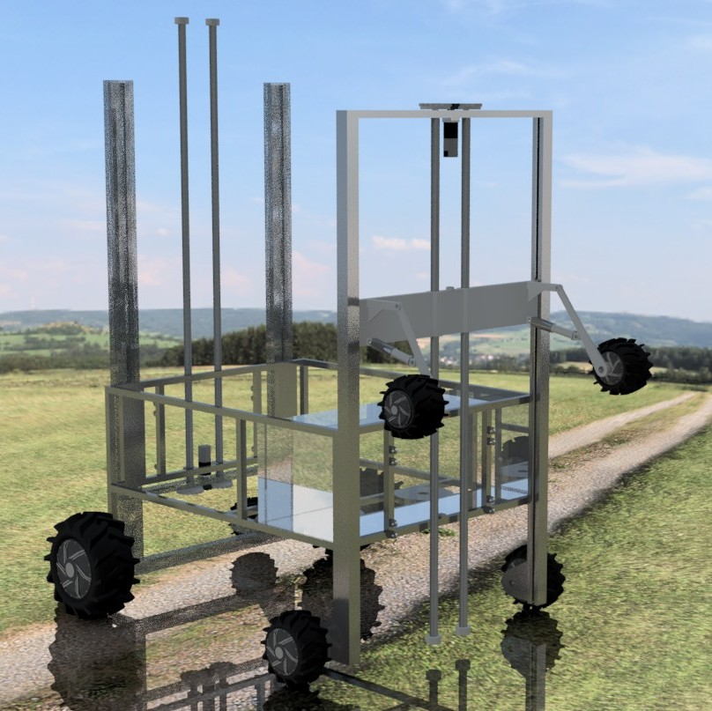
FarmBot
Agrobot Design Innovation Challenge
Inter IIT Tech Meet 9.0

Slide 2
Achieved Goals and Approach

Slide 3
Achieved Goals
Mechanized farming in hilly terrain
Seed metering mechanism for uneven or irregular seeds (many crops, including ginger and turmeric)
Automation of transplantation method of farming
Automated weed removal in farms

Slide 4
Mechanical Design and Modules

Slide 5
Mechanical Design
FarmBot features 3 modules along with a climbing mechanism which enables the bot to climb both inclines and terrace-farming steps.
The 3 modules are:
Ploughing + Seed Metering Module
Transplantation Module
Weed Removal Module

Slide 6
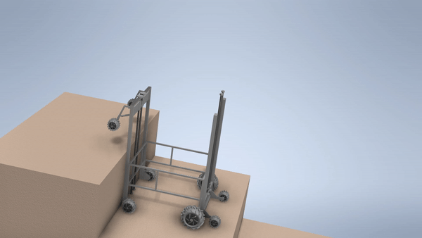
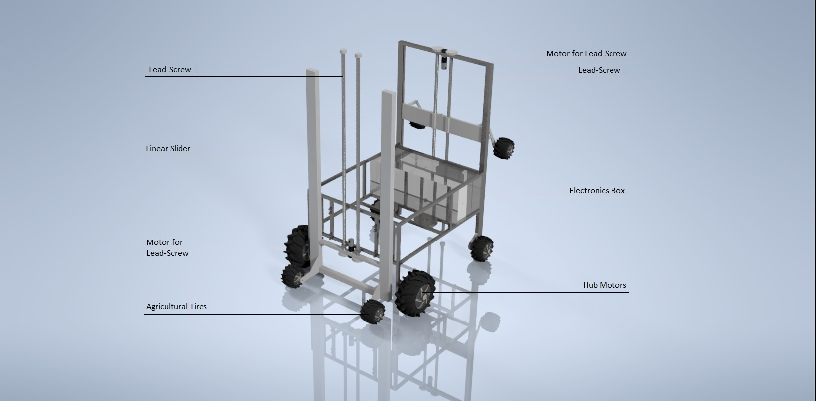
Stair Climbing Mechanism

Slide 7
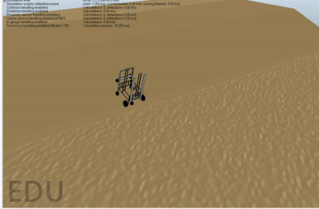
Slope Climbing
We tested our bot on different slopes in simulation
Dynamic analysis and simulation show that FarmBot can climb at 40 degree of slope without turning over
Kept COM of bot close to the ground for stability.

Slide 8
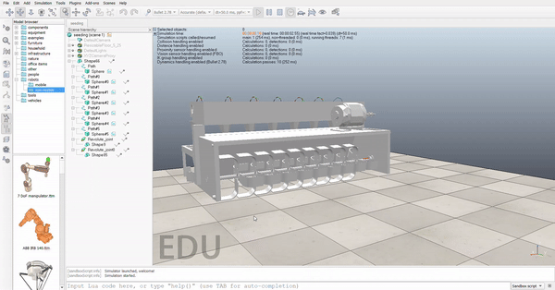
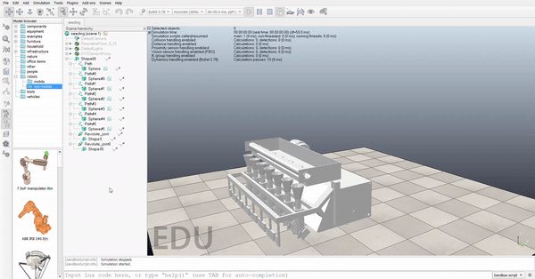
Seed Metering
Designed for sowing all kinds of seeds.
Seeds are sucked by needles from a tray and put in a hopper which then plants them into the soil.
Adjustable needles to accommodate variety of seeds.

Slide 9
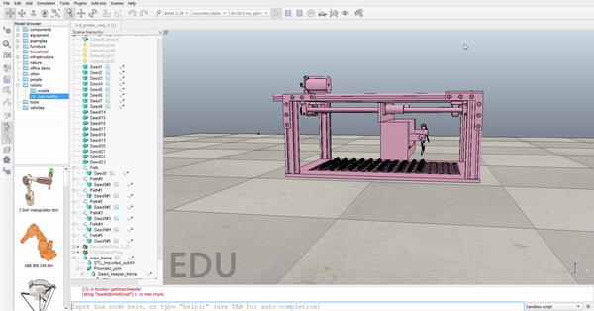
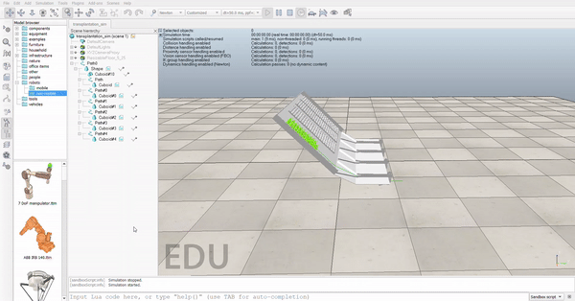
Transplantation
Comprises of a honeycomb shaped paper trays which contain the sapling and an automated seeding mechanism for the tray.
Can carry upto 264 saplings which can be planted at varied spacing of 2”, 4” or 6”.

Slide 10
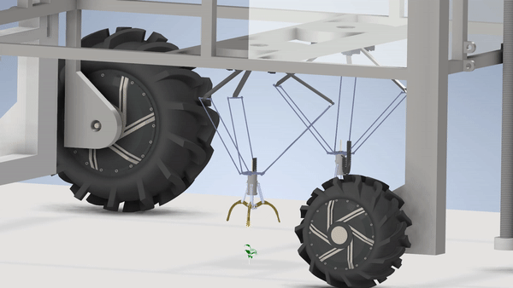
Weed removal
We use Computer vision algorithms to differentiate and detect the position of weed.
The robot can eliminate weeds both chemically and mechanically.
We use 3 motors in delta mechanism to provide movement of the grabber claw which is used to pluck out the weeds. There is a herbicide pump attached to it too.
Add image

Slide 11
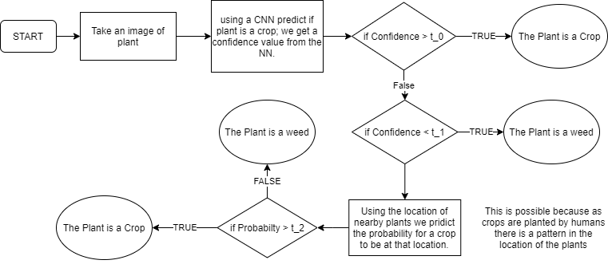
Algorithm for Weed Detection
Notes:
https://www.ijeast.com/papers/606-609,Tesma403,IJEAST.pdf

Slide 12
Hardware Specifications and Cost Analysis
Module Name | Material Used | Major Dimensions (in cm) | Total cost( in Rs)
Main Bot | Al, S.S | (270,155, 360) | 2,55,000
Weeding module | Al | (70,70,72) | 18,200
Ploughing and Seeding module | Al, Plastic, S.S | (128, 180, 77) | 51,000
Transplantation module | Al, rubber | (128, 180, 77) | 9,500
 |  | Total | 3,33,700
A more detailed cost analysis and hardware specifications can be found here.

Slide 13
Electrical Design

Slide 14
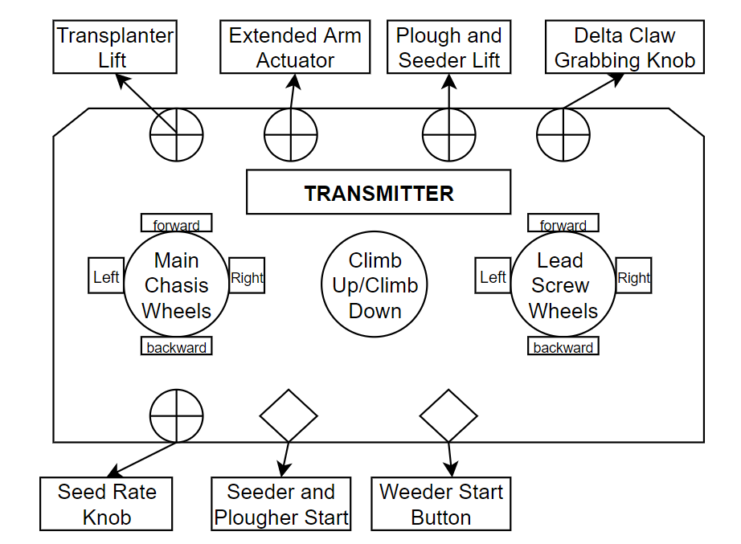
Remote Control
1.Three joysticks are used for the following tasks:
Controlling the movement of main chassis wheel motors
Climbing up and down the steps
Controlling lead screw wheels
2. Features controlled by a range of potentiometer dials:
Extended arm actuator
Control of seed rate
Transplanter lift mechanism
Delta claw’s grabbing mechanism
3.There are start-stop buttons for autonomous movement:
Delta for plucking and
Herbicide spray on weeds
For Plougher and Seeder
Notes:
Add animate for each bullet

Slide 15
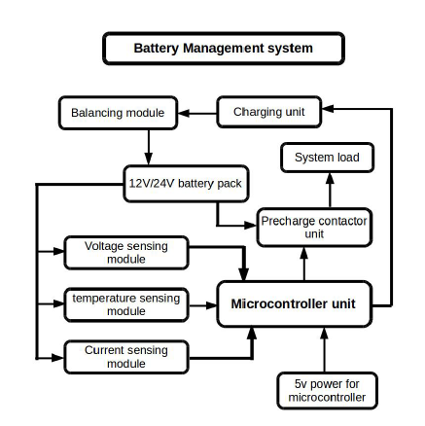
Battery Management
Parameter controlled through this system are:
Cell Voltage
Current
Temperature
Performance Optimization
Maintain all cells in a pack at their max capacity with equal voltage using individual cell balancing.
State of Health (SoH)
Real time values of temperature, voltage, current used to estimate SoH of battery
Notes:
We are accurately controlling SOC for each sell in our battery management system. It maintains all cells in the pack at their max capacity with equal voltage using individual cell balancing and cell voltage and current through cells. These values are also monitored to get an estimate of State of Heatlh of battery. Thus increasing overall efficiency.

Slide 16
Simulation
The link to the simulations is here.

Slide 17
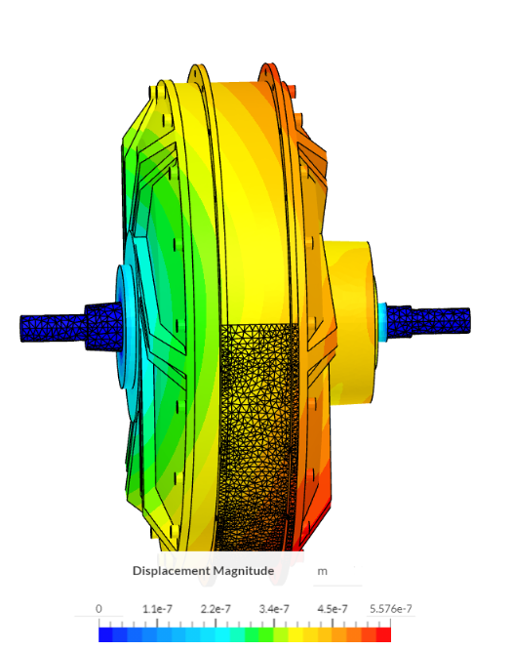
Dynamic Analysis Results
Some key takeaways from our analysis:
1. Even at a slope of 40 degrees, our bot can climb easily using motor of 2kW Power rating.
2. We performed stress simulation using Ansys to test the wheel’s rib design for plastic deformation.
3. We did structural analysis on axial+bearing force iteratively on the diameter of the lead screw to check the diameter for which it will not buckle up.
Notes:
All the specs of our robot was decided by solid analysis and simulation. We used various tools like Vrep and Ansys to come chose optimal values. From the simulation of the climbing mechanism, we calculated the torque of the motor used in the lead screw.

Slide 18
Why FarmBot?

Slide 19
FarmBot over Conventional methods
Our robot is quicker, more cost-effective compared to current methods.
Transplantation
Seeding+Ploughing
Weeding (Manual)
4 hectares/day
3 hectares/day
2 hectares/day
16x
3x
10x
0.25 hectares/day
1 hectares/day
0.2 hectares/day
Rs 3000-3200 savings/day
Rs 6600-7000 savings/day
Rs. 1000-1100 savings/day

Slide 20
Value Added for Marginalized Farmers
Some of the advantages it provides are:
Reduces need of manual labour drastically and increasing returns
Increases time-efficiency: farmer can utilise saved time constructively in other areas of work
Ease of operation: women, old people and differently abled people can contribute to the farm without enduring heavy physical workload
Semi-autonomous operation

Slide 21
Compatibility and Ease of Operation in Small Agricultural Lands
We believe that there are many methods by which it can be made accessible as well:
Incorporating an EMI Model
Adopting a Co-operative Model for acquisition of FarmBot
National and State Level Subsidies

Slide 22
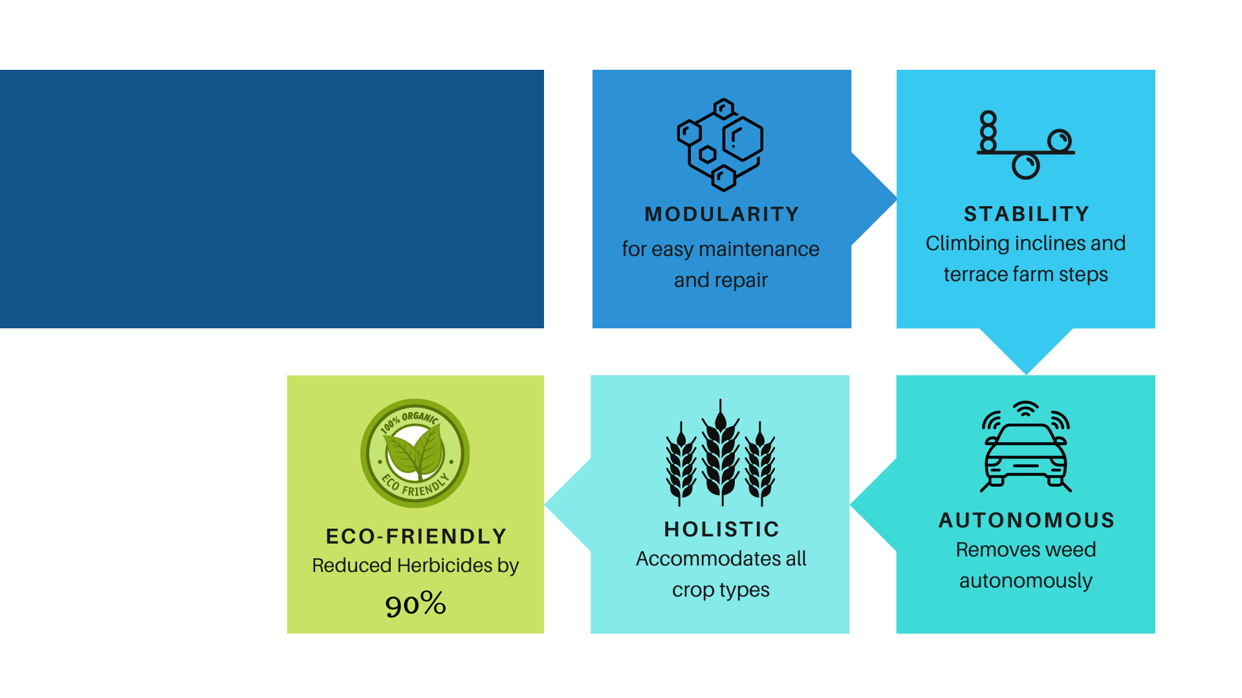
Noteworthy Features
Noteworthy Features

Slide 23
“If agriculture fails, everything else will fail”
- M S Swaminathan Father of India’s Green Revolution

Slide 24
Thank You!

